Slide 1
Wave Graphs

Slide 2
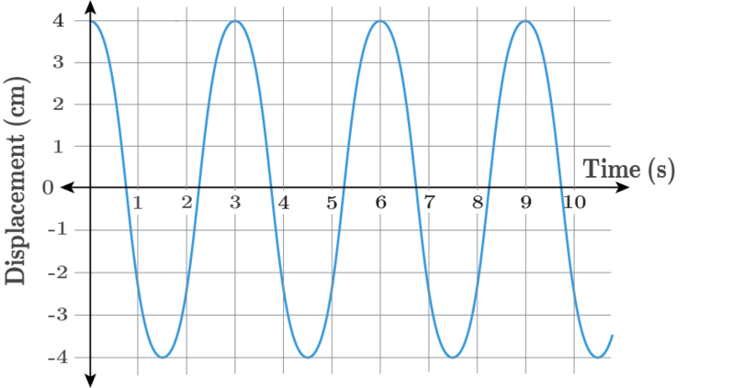
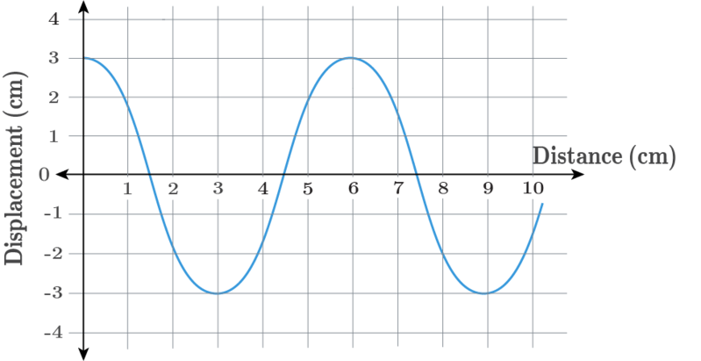
When you have completed this lesson you should be able to:
Understand the terms wavelength, amplitude and period.
Determine wavelength, amplitude and period from displacement-distance and displacement-time graphs.
Draw waves on displacement-distance and displacement-time graphs.

Slide 3
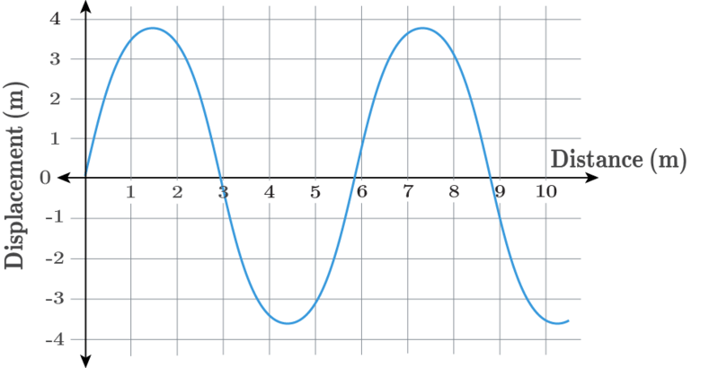
The first way to represent wave motion is on a displacement-distance graph.
A displacement-distance graph shows the displacement of all particles, from their undisturbed or resting positions, along the length of the wave at a particular point in time.
The y-axis shows the displacement of the particles while the x-axis shows the distance from the source of the wave. The graph below is an example of a continuous wave on a displacement-distance graph.

Slide 4
On a displacement-distance graph we can represent both transverse and longitudinal waves.
For transverse waves it shows the displacement of the particles from their resting position at different distances from the wave source at a specific point in time.
For longitudinal waves it also shows the displacement of particles from their resting position. However, we need to calculate the displacement of the particles in a longitudinal wave (as their displacement is parallel to the wave motion). Displacement in the same direction as the wave motion is defined as positive displacement. Thus arrows pointing to the right on the longitudinal wave correspond to upward facing arrows on the displacement-distance graph.
Displacement in the opposite direction to the wave motion is defined as negative displacement. This means arrows pointing to the left on the longitudinal wave correspond to the downward facing arrows on the displacement-distance graph. The length of the corresponding arrows on both graphs are the same as they both show the particle's displacement from its resting position.

Slide 5
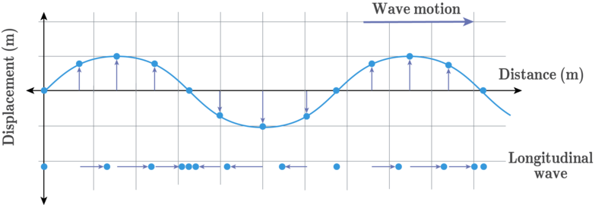

Slide 6
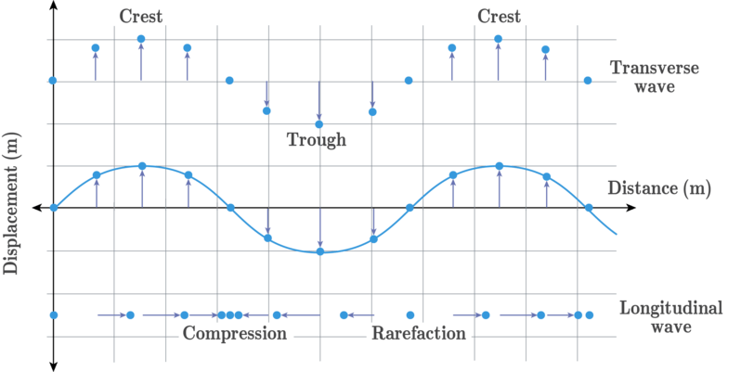
Specific locations in the waves are easy to identify from the displacement-distance graphs.
The crests of a wave represent the maximum positive displacement of the particles while the troughs represent the maximum negative displacement of the particles.
In the image below we have both transverse and longitudinal waves represented in the displacement-distance graph. By comparing these graphs, we can see that the compressions and rarefactions in longitudinal waves correspond to points where the displacement-distance graph crosses the x-axis.

Slide 7
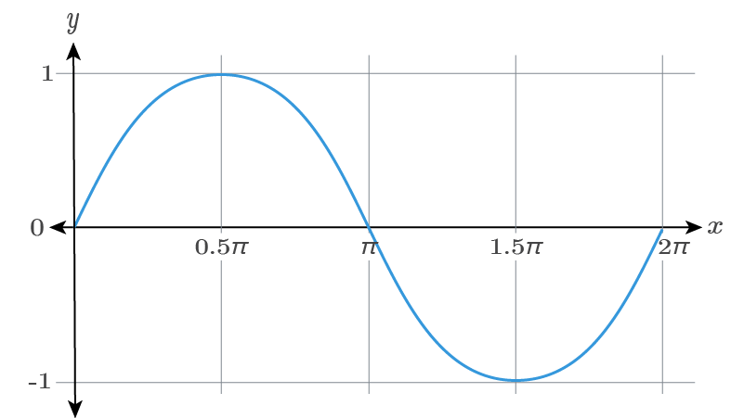
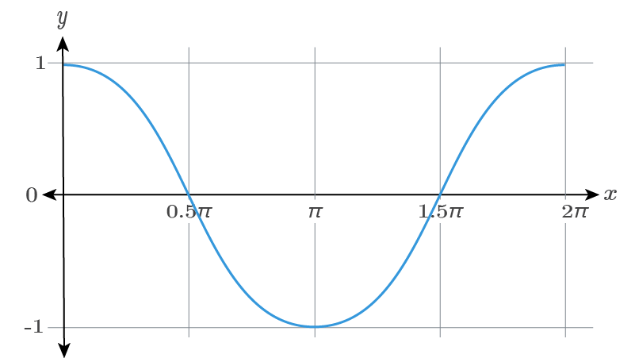
The representation of a wave on a displacement-distance graph is well known.
Physicists and mathematicians quickly realised that wave motion looks exactly like a sine (or cosine) graph. Because of this similarity wave motion is said to be sinusoidal (like a sine wave). Additionally, the motion of the individual particles is said to be a sinusoidal oscillation¹.
¹An oscillation is a repetitive motion about a central value, like the vibration of particles in a wave about their resting positions.

Slide 8
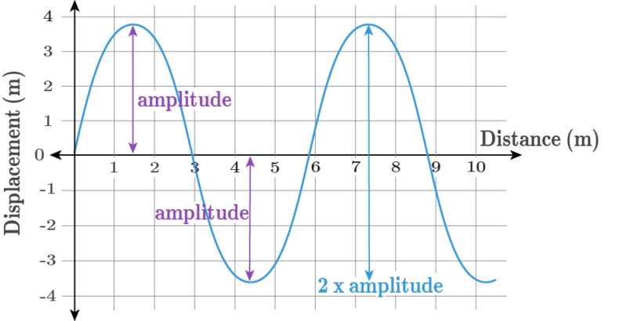
We can use the displacement-distance graphs to identify two key properties of waves.
The first key property of a wave is its amplitude. The amplitude of a wave is defined as the maximum displacement of a particle from its resting position.
The amplitude can be identified from the displacement-distance graph as the vertical distance from the x-axis to a crest (or trough) in the wave. It can also be identified as half of the vertical distance between a crest and a trough in the wave.

Slide 9
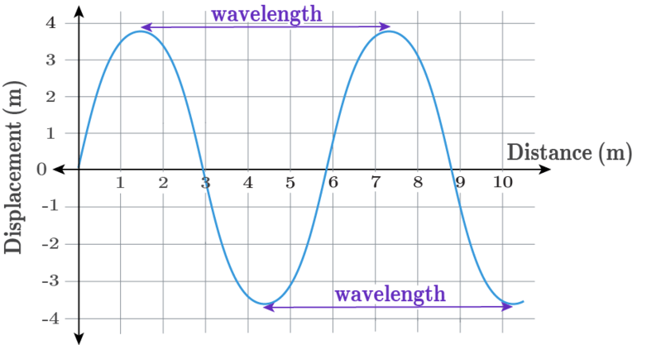
The second key property of a wave is its wavelength.
The wavelength of a wave is defined as the distance between two successive corresponding positions in a wave. For example, the wavelength can be defined as the distance between two crests or the distance between two troughs.
The wavelength of a wave is sometimes referred to as one cycle in the wave, as the motion of the particles repeats after one wavelength.

Slide 10
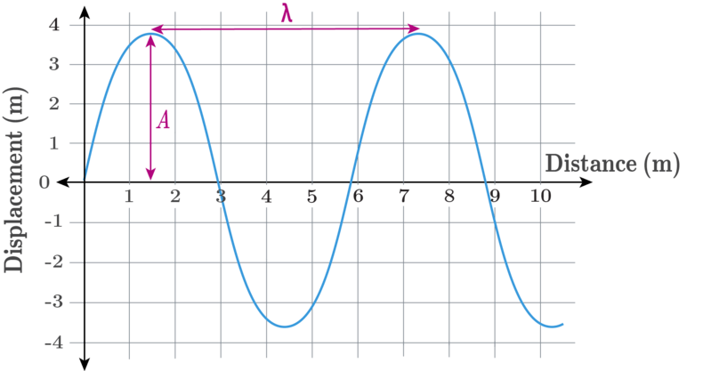
These two key properties of displacement-distance graphs are both measured in metres.
The amplitude of a wave is often denoted A and is measured in metres. The wavelength of a wave is often denoted by the Greek symbol lambda, λ, and is also measured in metres.
During one cycle of the wave (or one wavelength) the particles return to their resting position twice (cross the x-axis twice).

Slide 11
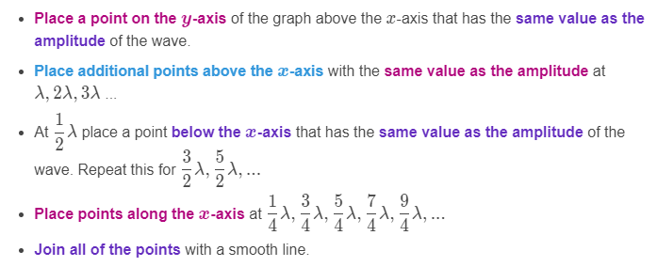
Drawing displacement-distance graphs starting at a peak.
The instructions below outline a method of drawing a displacement-distance graph starting at a peak.

Slide 12
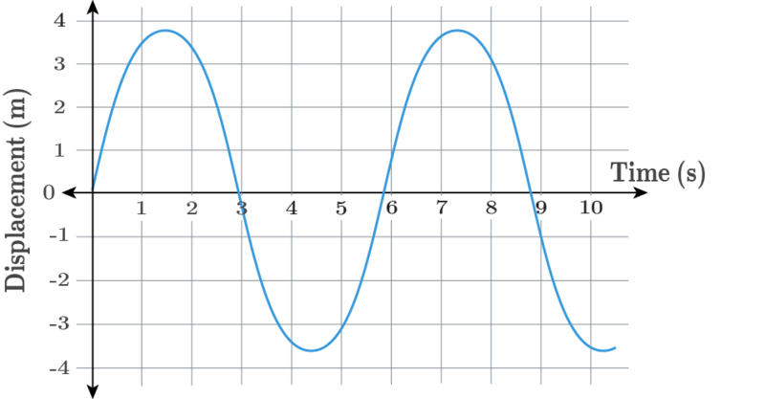
The second way to represent wave motion is on a displacement-time graph.
A displacement-time graph follows the motion of an individual particle in the wave and shows its displacement from its resting position over time.
An example of a continuous wave on a displacement-time graph is given below.

Slide 13
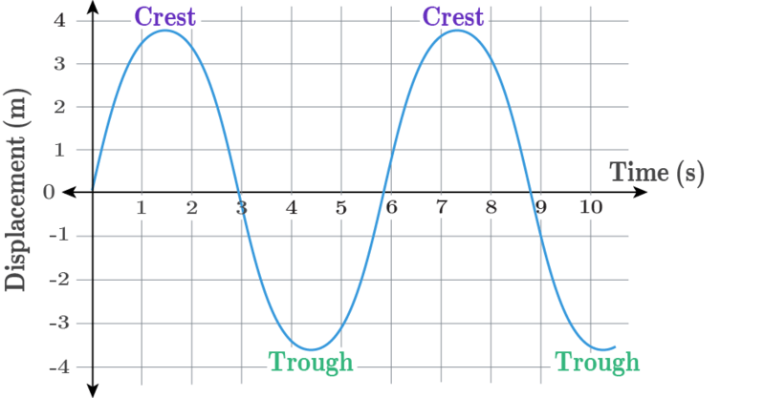
Some of the features of a displacement-distance graph can also be identified on a displacement-time graph.
A displacement-time graph can represent either transverse or longitudinal waves and also depicts sinusoidal motion.
The y-axis of a displacement-time graph also shows the displacement of a particle in the wave. Therefore both wave crests and troughs can be identified on a displacement-time graph. The crest in the wave represents the maximum positive displacement of the particle while the trough represents the maximum negative displacement of the particle.

Slide 14
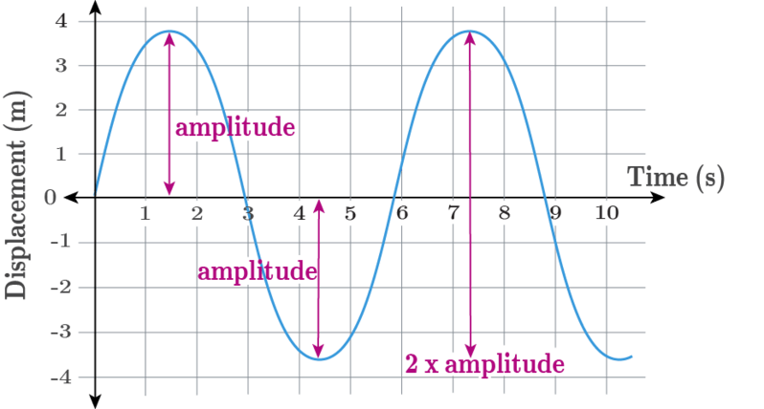
We can use the displacement-time graph to identify amplitude in the same way as we used the displacement-distance graph.
The amplitude can be identified from the displacement-time graph as the vertical distance from the x-axis to a crest (or trough) in the wave. It can also be identified as half of the vertical distance between a crest and trough in the wave.

Slide 15
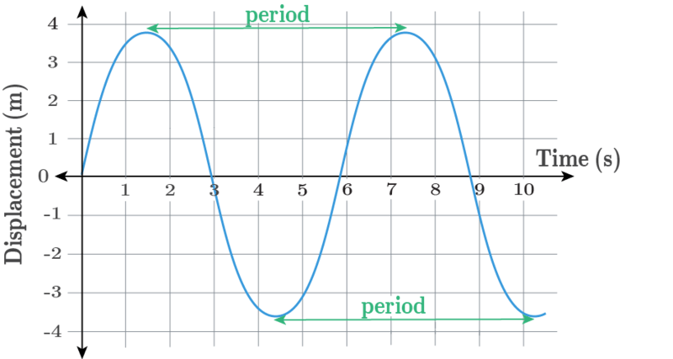
A displacement-time graph does not show wavelength.
On a displacement-time graph the time between successive corresponding positions on the wave is shown rather than the distance. This time between successive corresponding positions in the wave represents the wave period.
The period of a wave is defined as the time it takes to complete one cycle (wavelength) of the wave. The period is denoted by T and is measured in seconds, s.

Slide 16
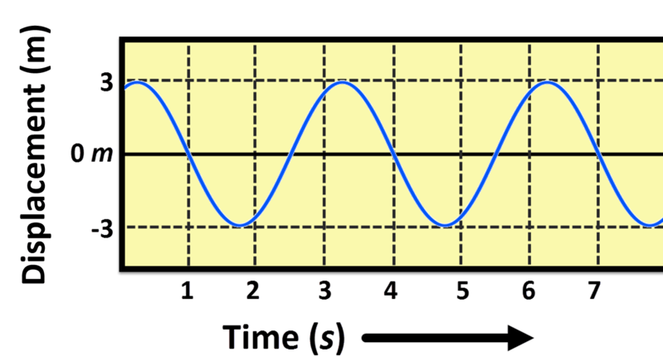
An oscilloscope is standard lab gear that can "hear" sound.
Oscilloscopes convert the sound signal into an electrical wave signal and display it on a screen.
The electrical wave signal produced by an oscilloscope is in the form of a displacement-time graph. Thus, we can use an oscilloscope to identify the amplitude and period of a wave.

Slide 17
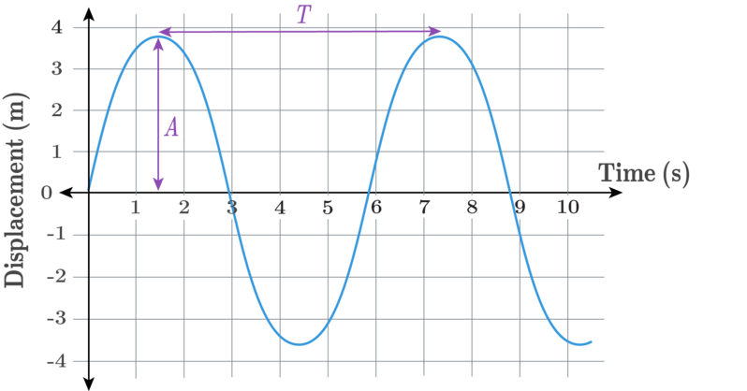
In summary, we can find different wave properties from the two different wave graphs.
We can use either graph to determine the amplitude of a wave as both wave graphs show the displacement of a particle from its resting position.
In contrast, we can only use a displacement-distance graph to determine the wavelength of the wave and we can only use a displacement-time graph to determine the period of a wave.
We can draw displacement-distance graphs and displacement-time graphs following the same methods.

